Slide 1
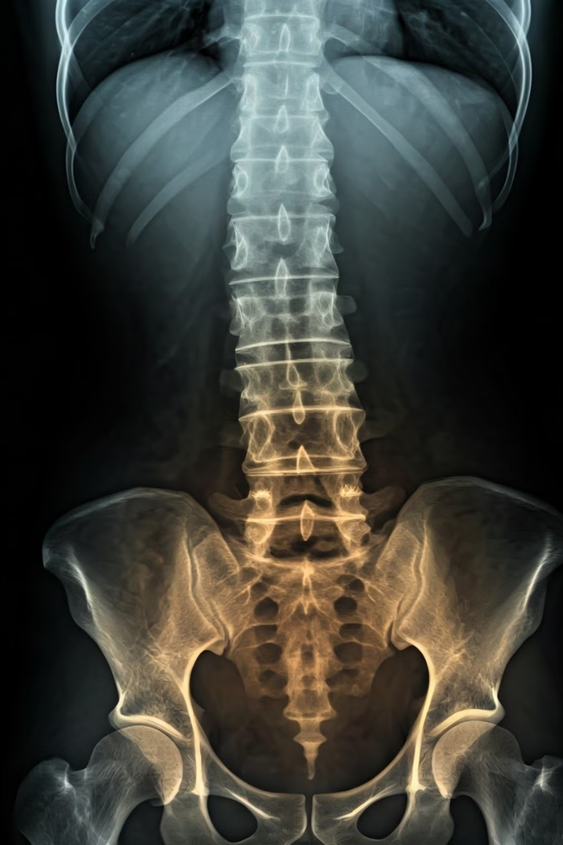
Automated Scoliosis Detection Using X-Ray Images and Machine Learning
Scoliosis is a common spinal condition, often diagnosed during adolescence, that causes an abnormal curvature of the spine. Early detection is crucial for effective treatment and improving patient outcomes.

Slide 2
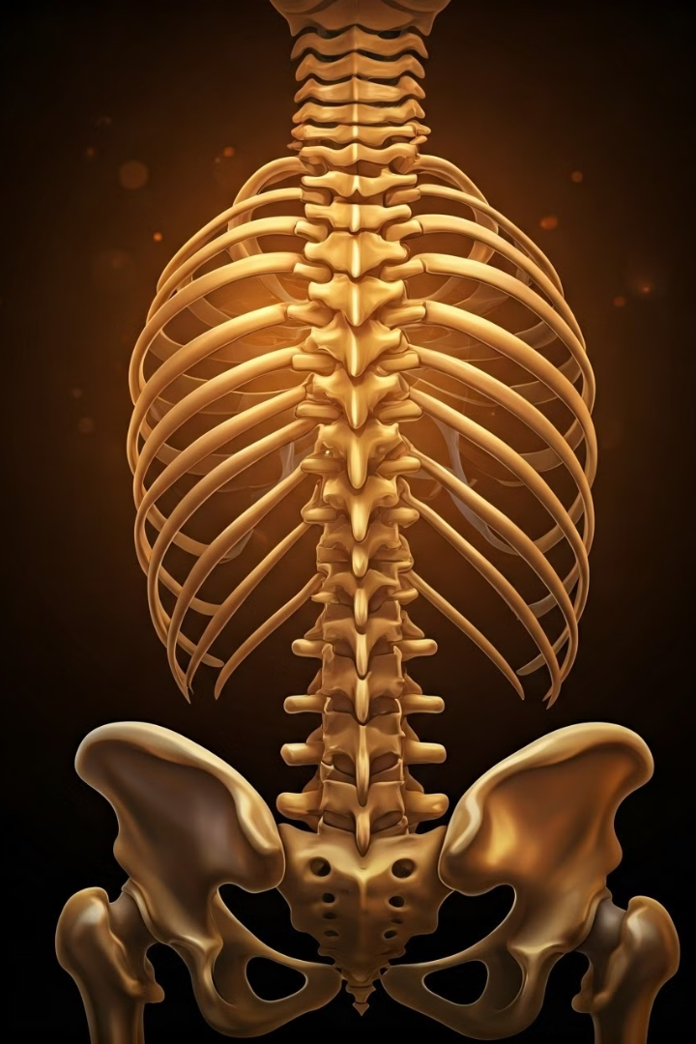
Understanding Scoliosis
1
Types of Scoliosis
2
Significance of Early Detection
The most common type is Adolescent Idiopathic Scoliosis, which develops during the growth spurt before puberty.
Early diagnosis allows for timely interventions, such as bracing or surgery, which can prevent further progression and improve patient outcomes.
3
Challenges with Traditional Methods
Manual assessment of X-rays is time-consuming, expensive, and can be subjective, leading to inconsistent diagnoses.

Slide 3

Automated Scoliosis Detection
Project Objective
Leveraging Machine Learning
Develop an automated method for scoliosis detection using machine learning algorithms applied to X-ray images.
Machine learning models can analyze X-ray images more efficiently and consistently than manual assessment.
Potential Impact
Future Applications
This automated system could improve early detection, leading to better treatment outcomes and reduced healthcare costs.
The technology could be expanded to other musculoskeletal conditions, enhancing diagnostic capabilities in orthopedics.

Slide 4

Data Collection and Preprocessing
1
Data Collection
Curating a comprehensive dataset of X-ray images from diverse patient populations.
2
Image Preprocessing
Applying techniques like normalization, resizing, and segmentation to prepare the data for model training.
3
Annotation and Labeling
Enlisting medical experts to accurately label the X-ray images with scoliosis severity and other relevant features.

Slide 5
Machine Learning Model Architecture
Convolutional Layers
Pooling Layers
Dense Layers
The model uses convolutional layers to extract relevant features from the X-ray images.
Pooling layers reduce the spatial dimensions of the feature maps, improving computational efficiency.
The final dense layers classify the images based on the extracted features, identifying the presence and severity of scoliosis.

Slide 6

Model Training and Evaluation
1
Training Process
The model is trained on the annotated X-ray dataset, optimizing parameters to minimize classification errors.
2
Performance Metrics
Accuracy, precision, recall, and F1-score are used to evaluate the model's detection capabilities.
3
Comparison to Traditional Methods
The automated system demonstrates significantly improved speed, consistency, and reliability compared to manual assessment.

Slide 7




Potential Impact and Future Outlook
Early Detection
Enabling earlier diagnosis and intervention for improved patient outcomes.
Cost Savings
Reducing healthcare expenses by streamlining the diagnostic process.
Scalability
Potential for expansion to other musculoskeletal conditions and diagnostic applications.

Slide 8




Future Research Directions
Longitudinal Studies
Tracking the long-term effectiveness of the automated system in improving patient outcomes.
Multimodal Approaches
Integrating X-ray data with other imaging modalities, such as MRI or CT scans, to enhance diagnostic accuracy.
Explainable AI
Developing interpretable models that can provide clinicians with insights into the decision-making process.

Slide 9

Conclusion
Improved Outcomes
Cost-Effective Solution
Expanding Possibilities
The automated scoliosis detection system has the potential to significantly enhance early diagnosis and treatment, leading to better patient outcomes.
By streamlining the diagnostic process, this technology can reduce healthcare costs and make scoliosis screening more accessible.
The success of this project opens the door for further advancements in the application of machine learning to other orthopedic conditions.

Slide 10

Thank You
We appreciate your time and attention. Please feel free to ask any questions or provide feedback.

